Slide 1

COFFEE QUALITY ANALYSIS
This project is a complete analysis of coffee quality. which is consists of 31 columns and 207 rows.
The Coffee Quality Institute (CQI) is a non-profit organization
that works to improve the quality and value of coffee worldwide.

Slide 2

The average scores for different variables related to sensory attributes and total cup points are as follows:
Average Total Cup Points: 83.71
Average Aroma: 7.72
Average Acidity: 7.69
Average Body: 7.64
Average Clean Cup: 10
Average Flavor: 7.74
Average Sweetness: 10
Average Flavor: 7.74
Average Sweetness: 10
The analysis of the average scores provides insights into how each sensory attribute contributes
to the overall coffee quality, represented by the total cup points.
Aroma and flavor both have relatively high average scores.
Acidity and body have slightly lower average scores compared to aroma and flavor
The data shows a significantly higher number of Category Two defects compared to Category One defects.
This suggests that Category Two defects are more prevalent in the dataset.
coffee samples processed using the washing/wet method have a higher sum of total cup points
compared to other methods.

Slide 3
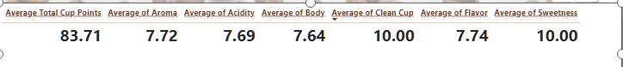
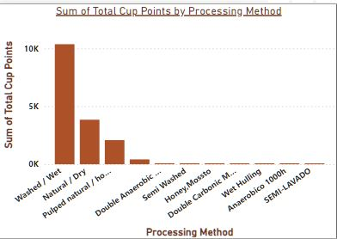
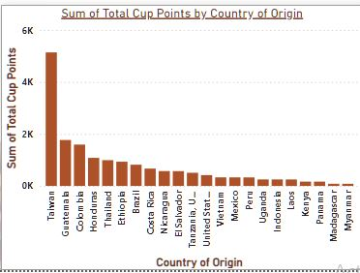
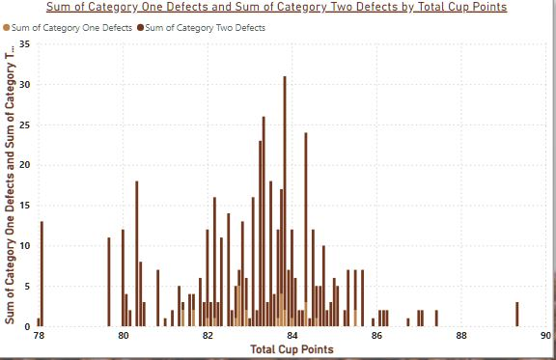
These are some reports from PBI which are key points to the total analysis

Slide 4
Recommendations:
Based on the analysis, it may be beneficial for coffee producers to focus on
optimizing processing methods and sourcing beans from regions known for producing high-quality coffee.
This could involve investing in infrastructure and training to improve processing techniques
and establishing partnerships with reputable coffee growers in quality-driven regions.
Given the higher prevalence of Category Two defects,
Coffee producers need to focus on improving processes to reduce these defects.
This could involve implementing better quality control measures during processing
and storage to ensure higher overall coffee quality.
This may involve refining processing methods,
sourcing high-quality beans and implementing rigorous quality control measures throughout production.

Slide 5

THANK YOU

